Slide 1

Differences Between Two Groups

Slide 2

Statistical Golems (sensu Richard McElreath)
ravenscar45

Slide 3
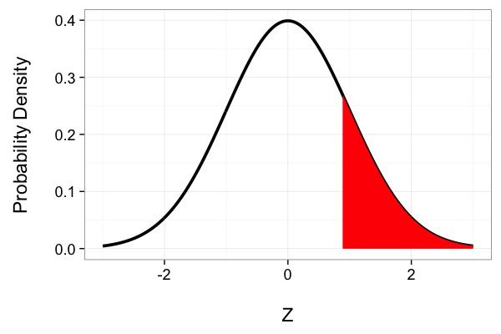
This is a Golem
What is my data generating process?
What is my error generating process?

Slide 4
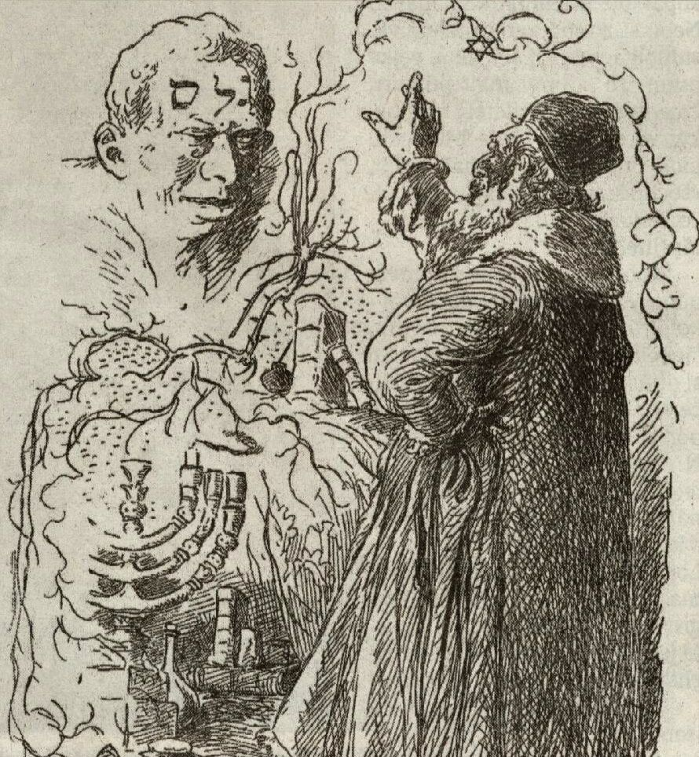
What Drives My Golem?
Assumption about Population
Drawn from Data
Assumption about Population
Drawn from Data

Slide 5
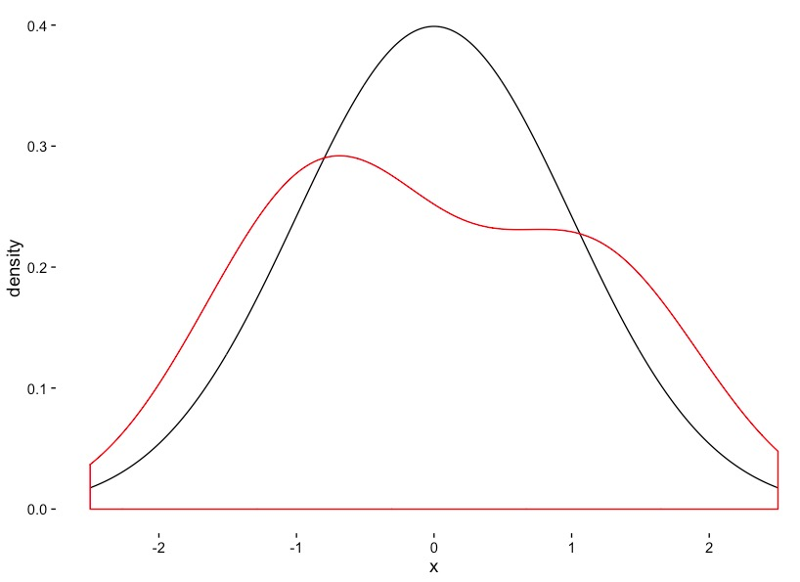
Is this a Good Golem for Realistic Sample Sizes?
Golem
N=5
Data

Slide 7
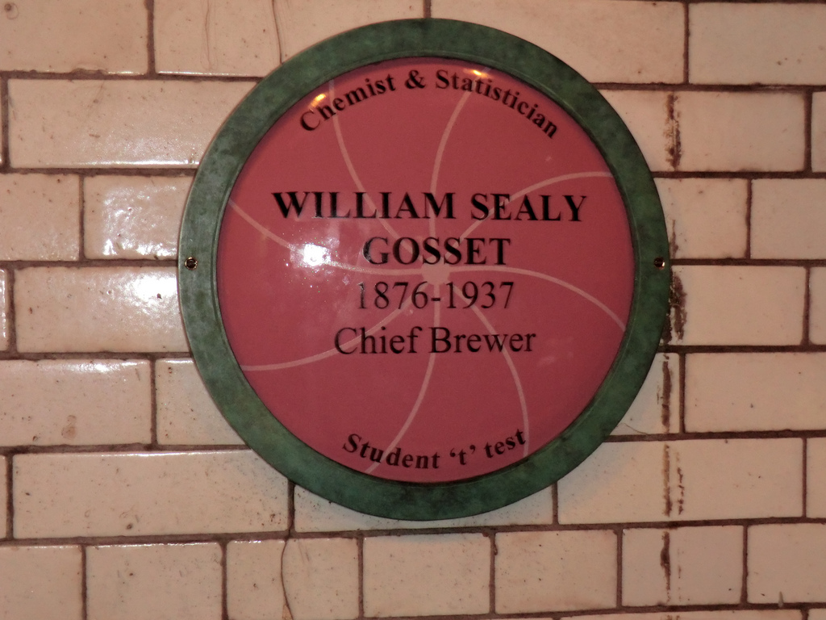

Slide 8
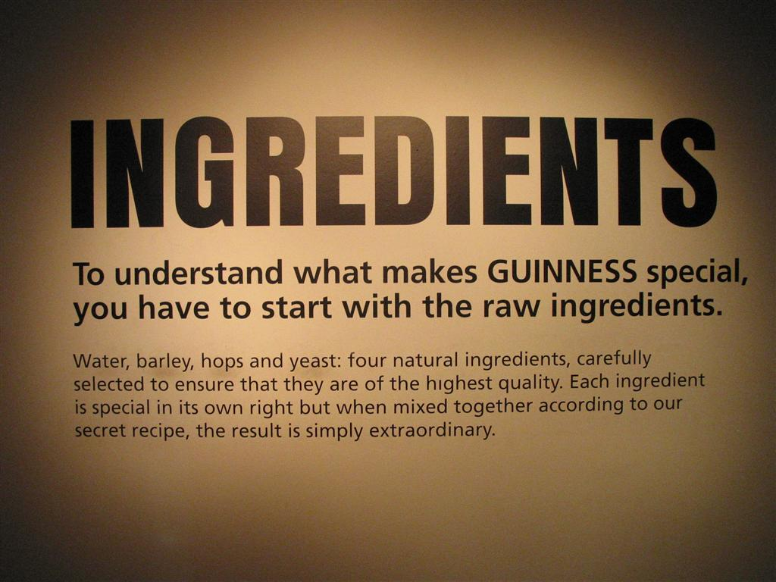

Slide 9
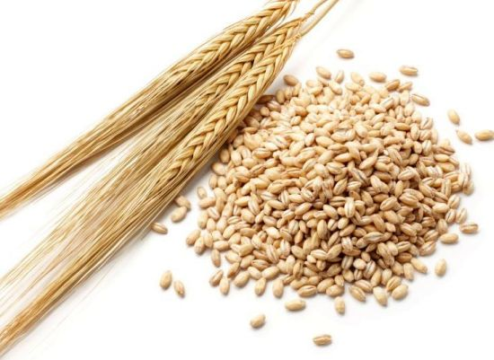
Does This Farm Produce Barley at the Right Moisture?
The Standard
N=5
Barley

Slide 10
What Does My Golem Know?
Assumption about Population
Drawn from Data
Drawn from Data
Drawn from Data
Evaluate against T Distribution with n-1 Degrees of Freedom

Slide 11
T Versus N
A Normal Distribution is defined by a mean and a SD
A T-Distribution assumes a mean of 0, a SD of 1, but changes shape based on its Degrees of Freedom

Slide 12
Degrees of What?
Let’s say you estimate a mean
Mean = (x1 + x2 + x3)/3
If you know the mean, x1, and x2, you can calculate x3
How much unique information is there in calculating a parameter?

Slide 13
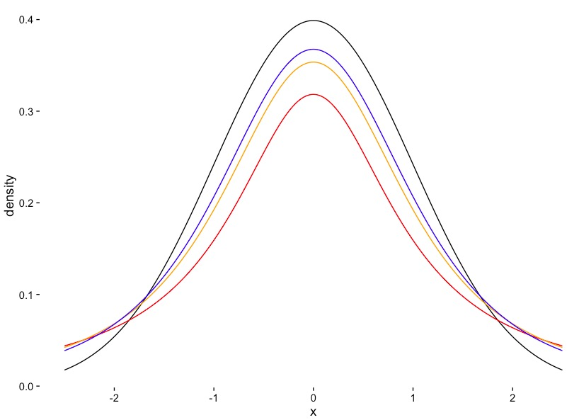
T Distribution Versus Normal
Normal
3DF
2DF
1DF

Slide 14
Comparing Paired Groups H₀: Difference = 0
Drawn from Data
Drawn from Data
Drawn from Data
Evaluate against T Distribution with n-1 Degrees of Freedom
N is the sample size per group

Slide 15
Comparing Groups H₀: Difference = 0
Pooled Sample SD = √(s₁ + s₂)
Evaluate against T Distribution with n-1 Degrees of Freedom
N is the sample size per group
Assumes equal sample size and equal variance of populations

Slide 16
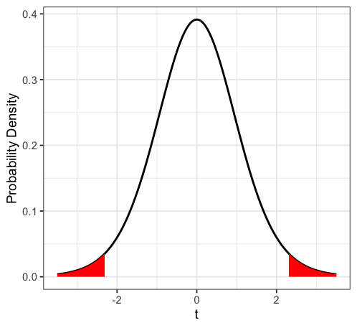
Evaluate for a P-Value

Slide 17
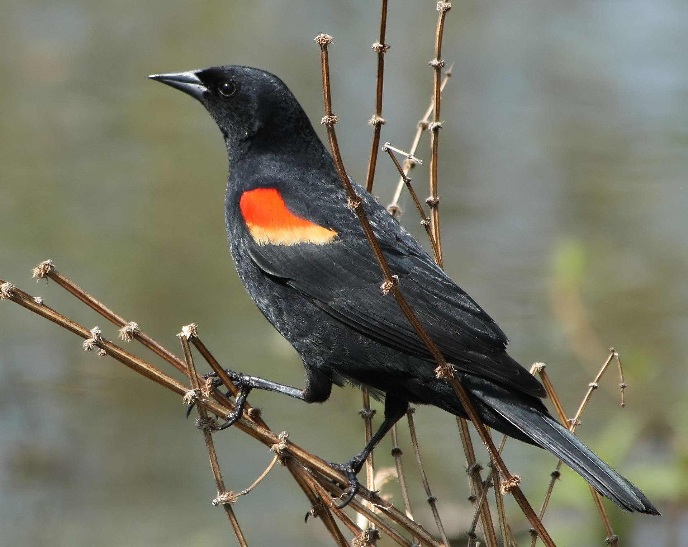
Testosterone and Birds

Slide 18
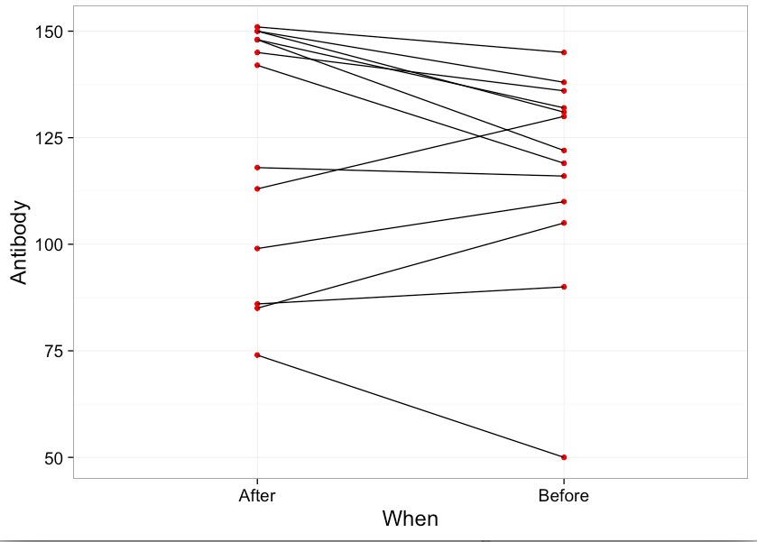
Differences in Antibody Performance

Slide 19
General Testing Workflow
Build a Test
Evaluate Assumptions of Test
Evaluate Results
Visualize Results

Slide 20
Comparing Paired Groups H₀: Difference = 0
Drawn from Data
Drawn from Data
Drawn from Data
Evaluate against T Distribution with n-1 Degrees of Freedom
N is the sample size per group

Slide 21
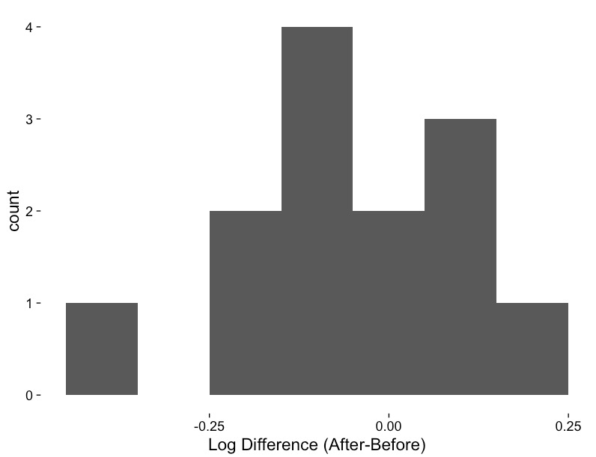
Is the Log Difference Different from 0?

Slide 22
General Testing Workflow
Build a Test
Evaluate Assumptions of Test
Evaluate Results
Visualize Results

Slide 23
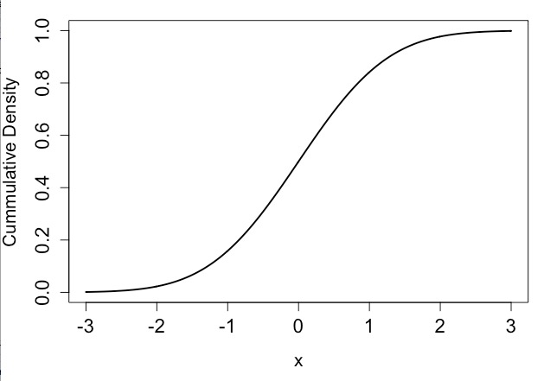
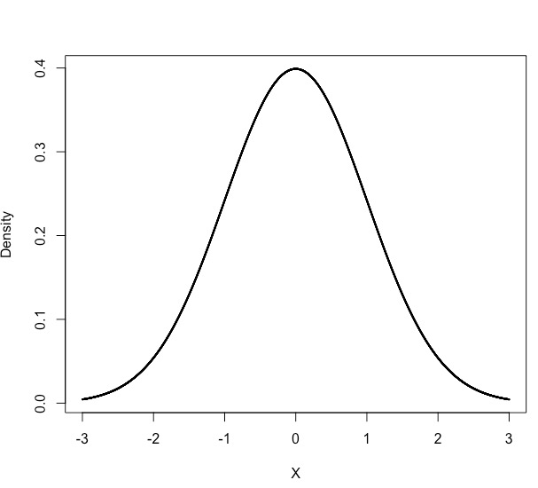
One Way to Evaluate If Your Golem is Good: Quantiles

Slide 24
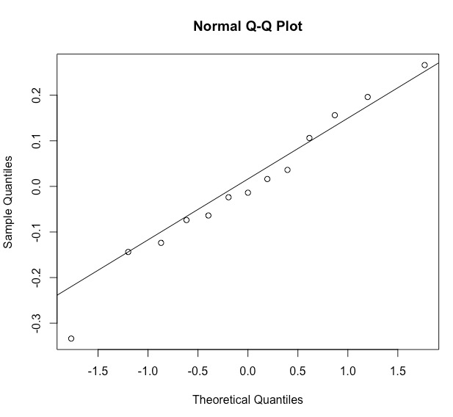
QQ Plot to Evaluate If Residuals are Normal
From Residuals
Line
From a Normal Distribution

Slide 25

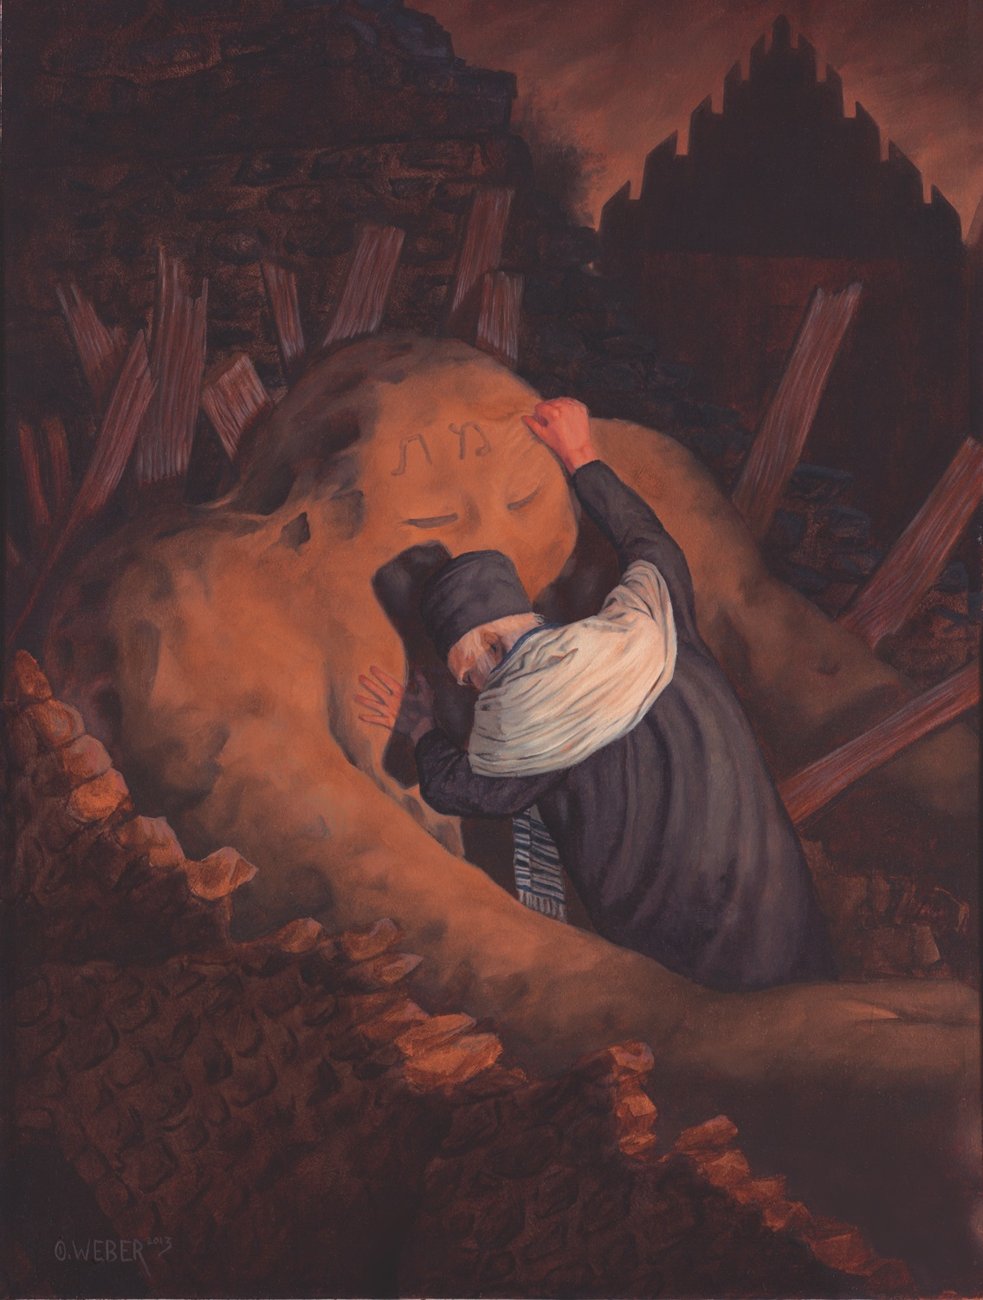
QQ Plot to Evaluate If Residuals are Normal

Slide 26
Troubleshooting Your Golem
Unequal Sample Sizes
Alternate Formula for Denominator
Unequal Population Variances
Welch’s T-Test (different denominator and DF)
Residuals Not Normal
Transform
Non-Parametric Test
Golem with a different error structure

Slide 27
General Testing Workflow
Build a Test
Evaluate Assumptions of Test
Evaluate Results
Visualize Results

Slide 28
General Testing Workflow
Build a Test
Evaluate Assumptions of Test
Evaluate Results
Visualize Results

Slide 29
Blackbirds: t = -1.51, df = 12, p = 0.16

Slide 31
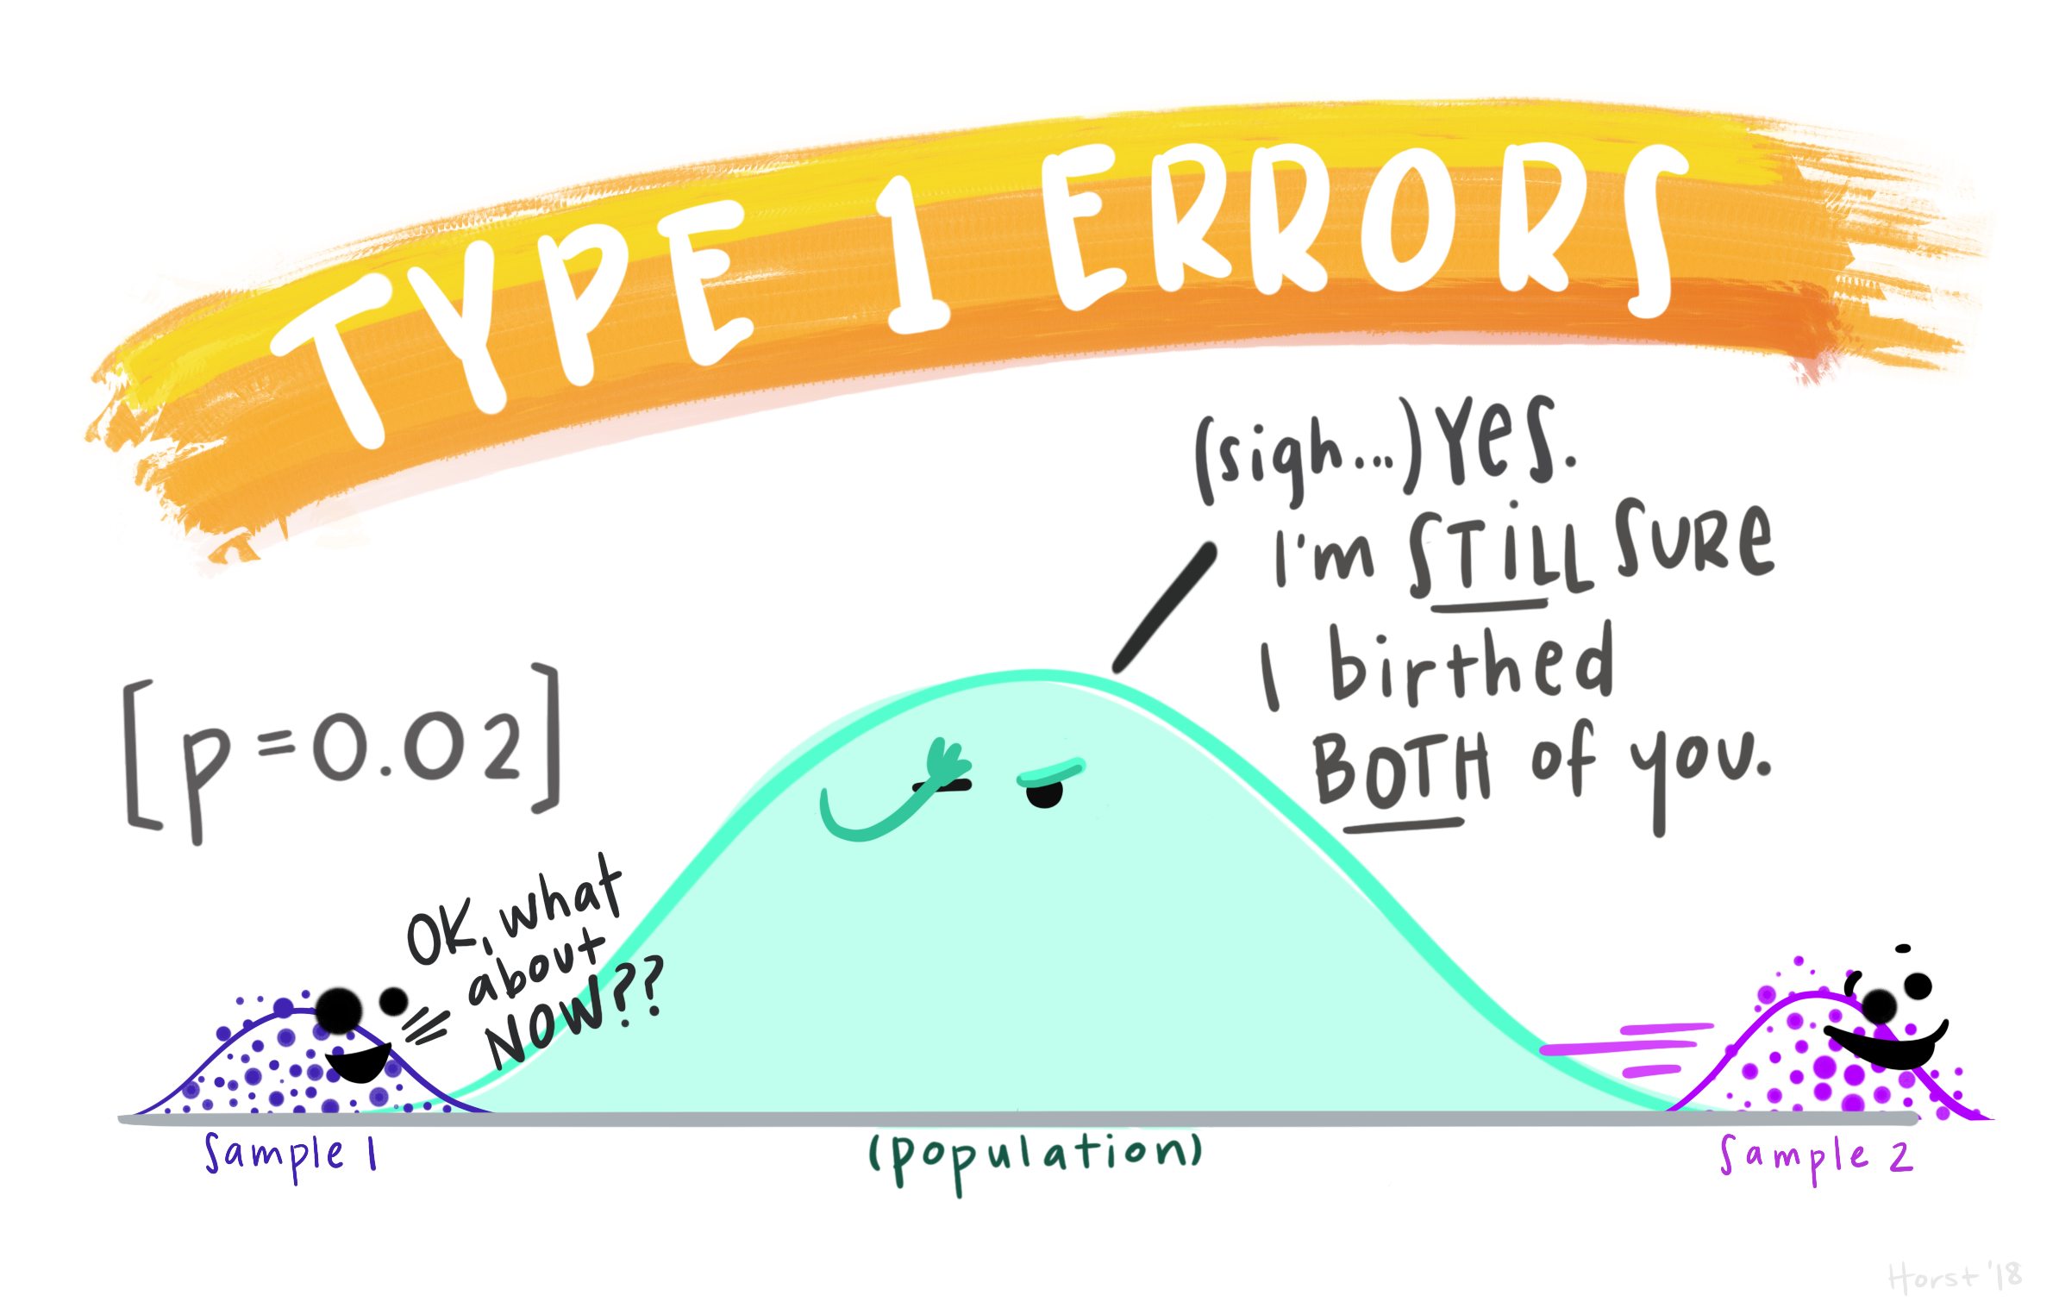
© Allison Horst, Stats and R Goddess, https://github.com/allisonhorst/stats-illustrations/

Slide 32
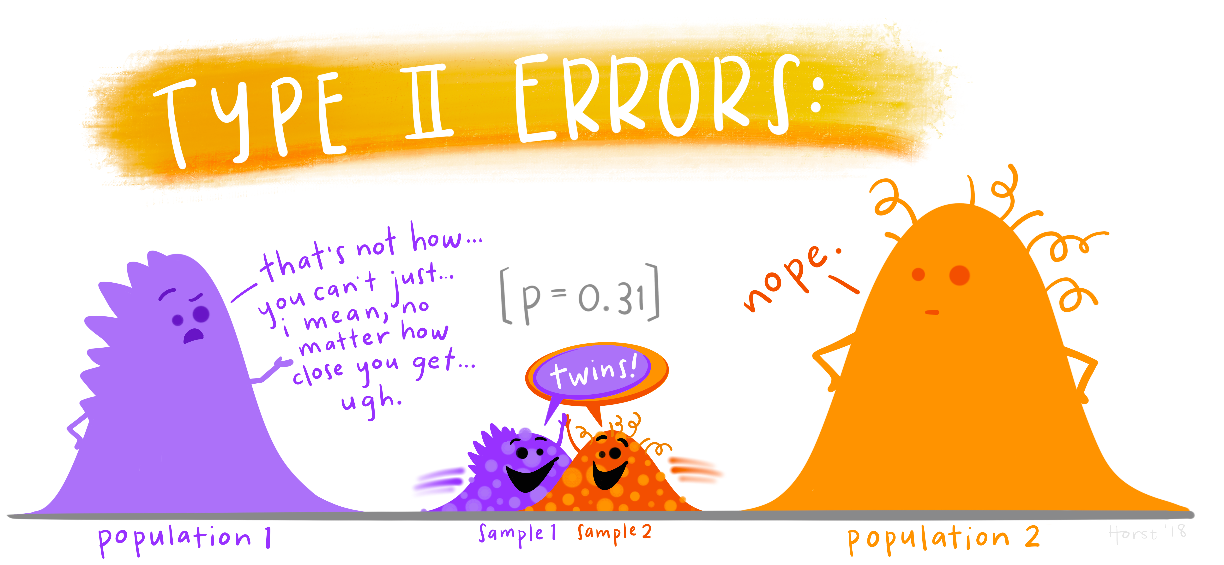
© Allison Horst, Stats and R Goddess, https://github.com/allisonhorst/stats-illustrations/

Slide 33
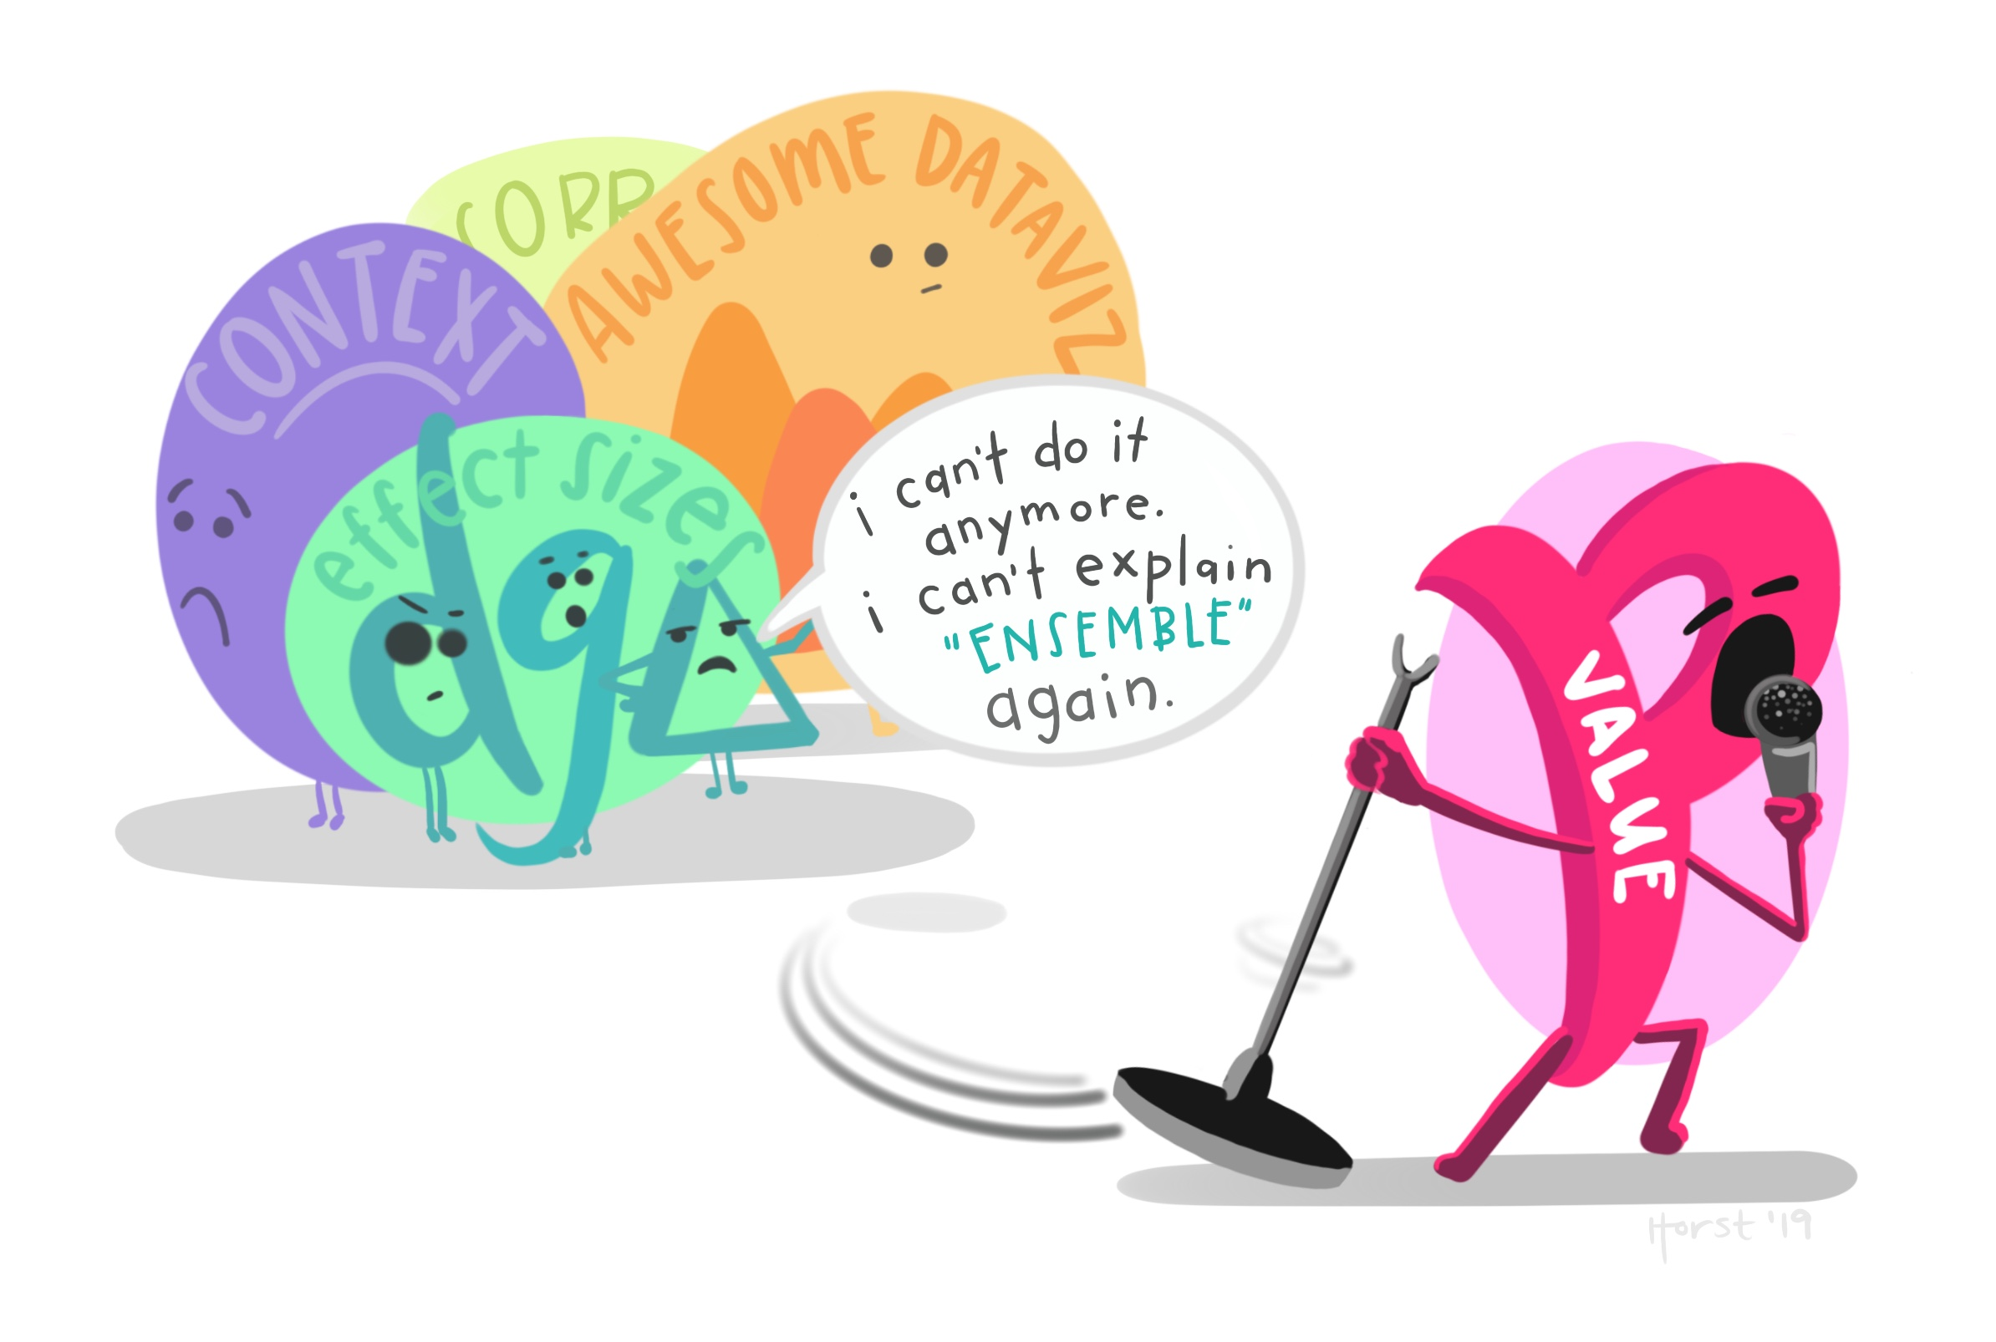
© Allison Horst, Stats and R Goddess, https://github.com/allisonhorst/stats-illustrations/

Slide 34
General Testing Workflow
Build a Test
Evaluate Assumptions of Test
Evaluate Results
Visualize Results

Slide 35
Differences in Antibody Performance

Slide 36
Is This a Big Difference?

